Slide 1


Rest Assured API Automation
Day 5 - (De)-serializing request and response bodies
Notes:
Dataprovider examples with static data
Dataprovider examples with data from excel
Need to cover Get call with Excel and Post call with json file

Slide 2
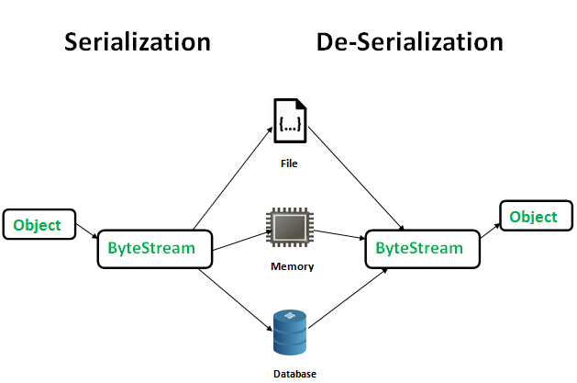
What is Serialization
Serialization is a process of converting objects into stream of data.
Serialization & deserialization processes are platform independent - meaning we can serialize object in one platform and deserialize it in different platform.

Slide 3
What is Deserialization
Deserialization is a process of converting stream of data into objects.
The main purpose of Serialization & deserialization is to persist the data and re-create whenever needed.

Slide 4
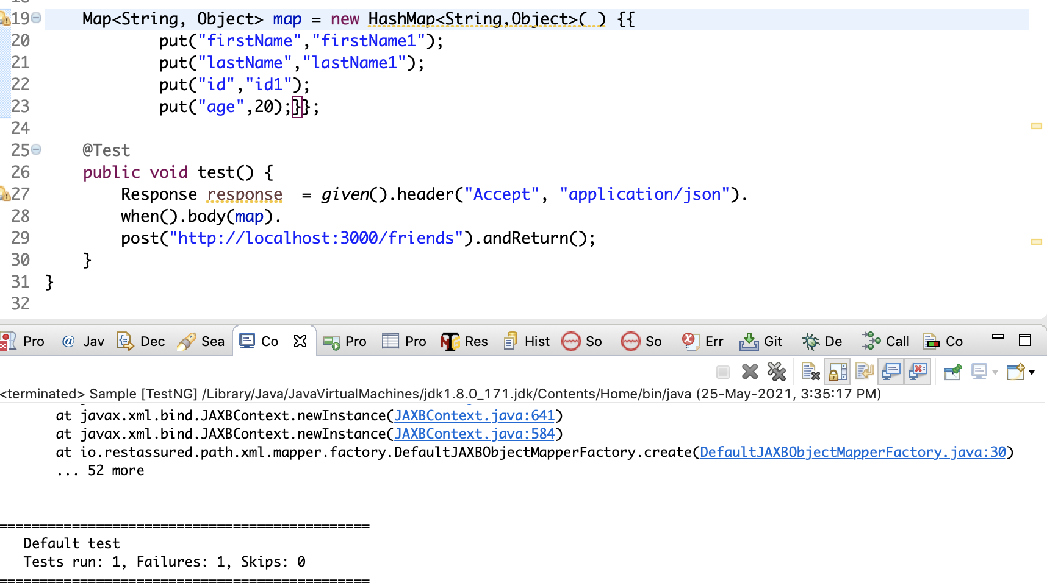
Why Serialization
POST request with request body as Map (with no object serialization library)

Slide 5
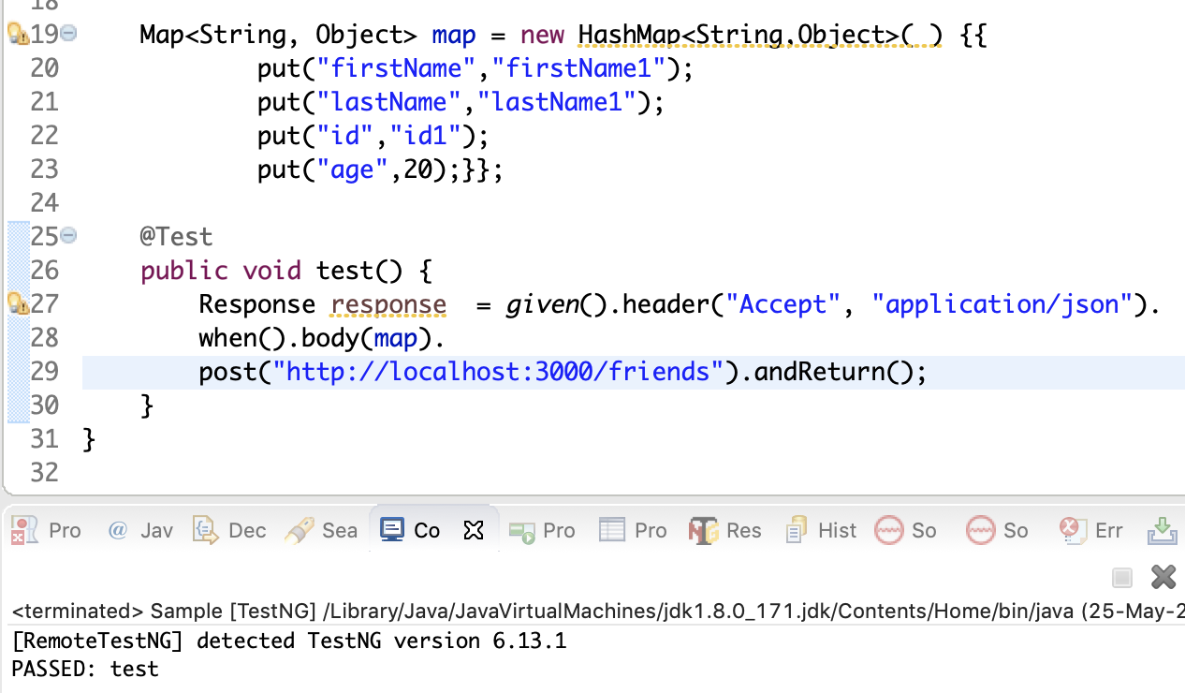
Why Serialization
POST request with request body as Map (with object serialization library)

Slide 6
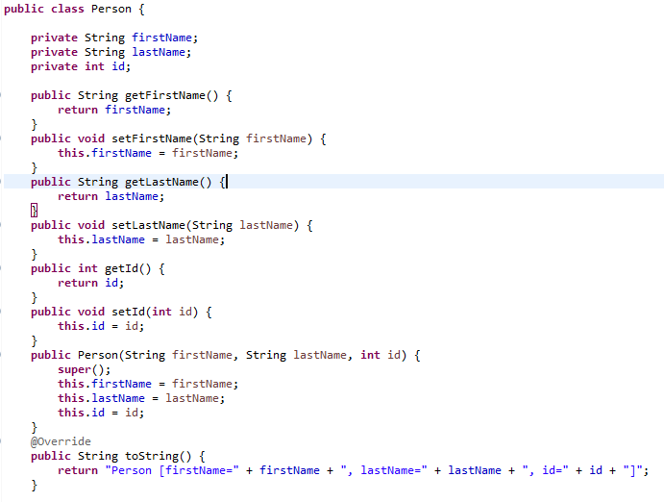
What is POJO
POJO stands for Plain Old Java Object .
It is normal/ordinary Java Object.
POJOs are used for increasing the readability and re-usability of a program.

Slide 7
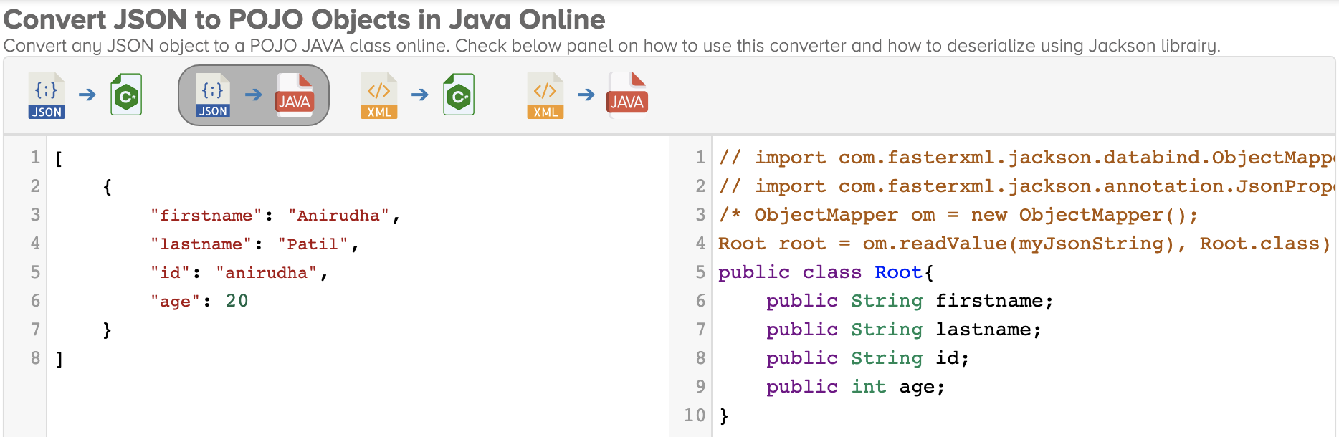
Json to POJO (online converter)
https://json2csharp.com/json-to-pojo

Slide 8
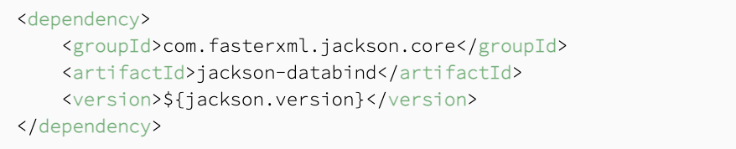
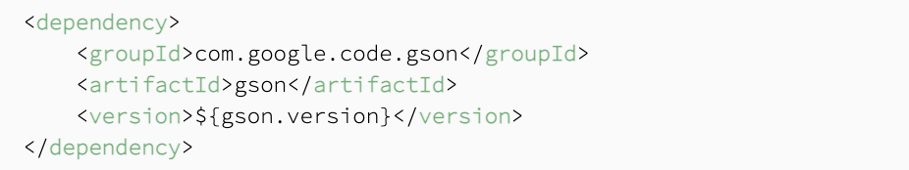
Libraries for Serialization & Deserialization
Jackson
Gson

Slide 9
Comparison of Jackson & Gson
Jackson is by far the heaviest library of them all, but it is also the fastest one.
Jackson is built in into some of the frameworks such as RestEasy, Restlet, Spring Framework.
Gson is the slowest at deserializing JSONs.
Jackson has extensive annotation support.
Gson does serialize objects relatively fast, the resulting JSON might be larger due to the HTML-compatible escape characters that Gson inserts into it.

Slide 10
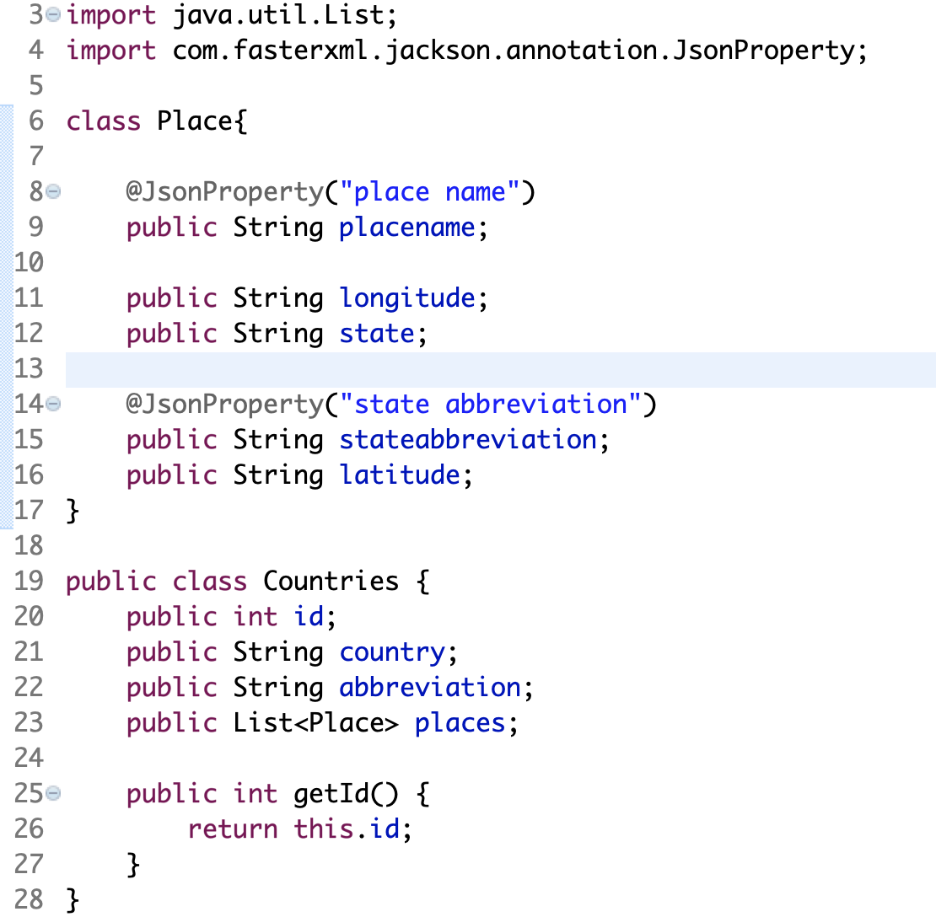
Sample GET request (map response to POJO)
Sample response :
[
{
"id":1,
"country":"India",
"abbreviation":"IN",
"places":[
{
"place name":"Janpath",
"longitude":"77.2167",
"state":"New Delhi",
"state abbreviation":"DL",
"latitude":"28.6333"
},
{
"place name":"Rail Bhawan",
"longitude":"77.2167",
"state":"New Delhi",
"state abbreviation":"DL",
"latitude":"28.6333"
}
]
}
]

Slide 11
Lombok
What is lombok and Why:
Lombok is used to reduce boilerplate code for model/data objects, e.g., it can generate getters and setters for those object automatically by using Lombok annotations.
Annotations
@Getter
@Setter
@AllArgsConstructor
@NoArgsConstructor
How to install
Setting up lombok in Eclipse and Intellij
https://www.baeldung.com/lombok-ide

Slide 12
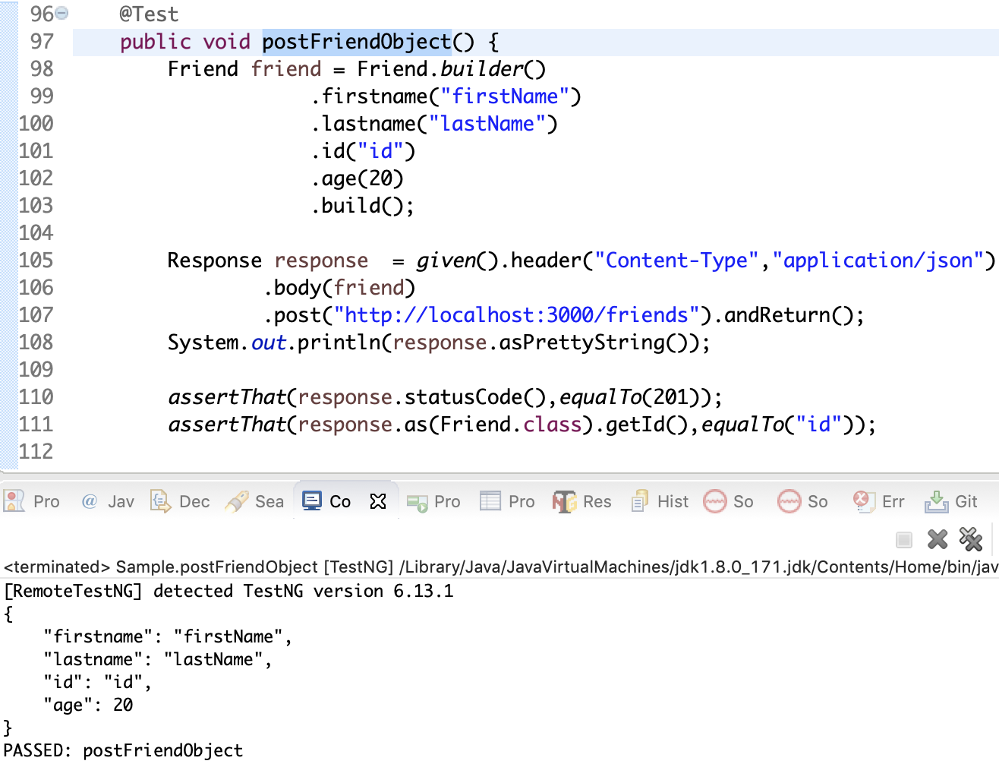
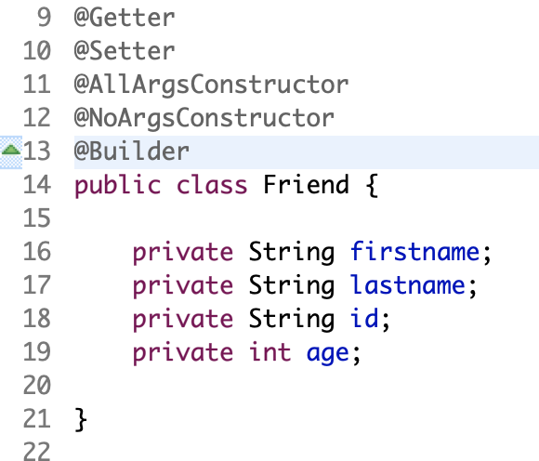
Sample POST request (map response to POJO)
POJO

Slide 13
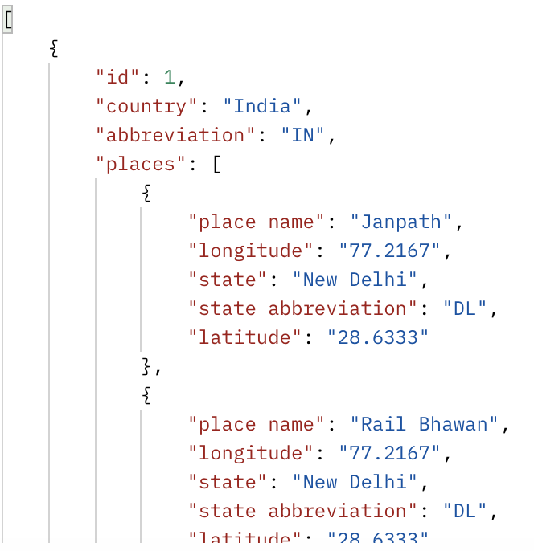
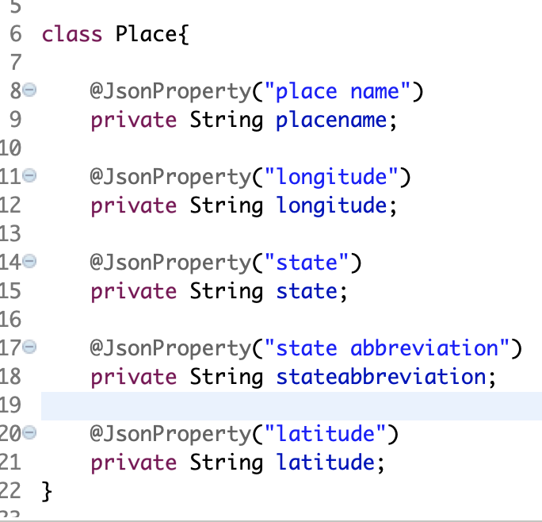
Jackson Annotations:
@JsonProperty:
@JsonProperty(name), tells Jackson ObjectMapper to map the JSON property name to the annotated Java field's name.

Slide 14
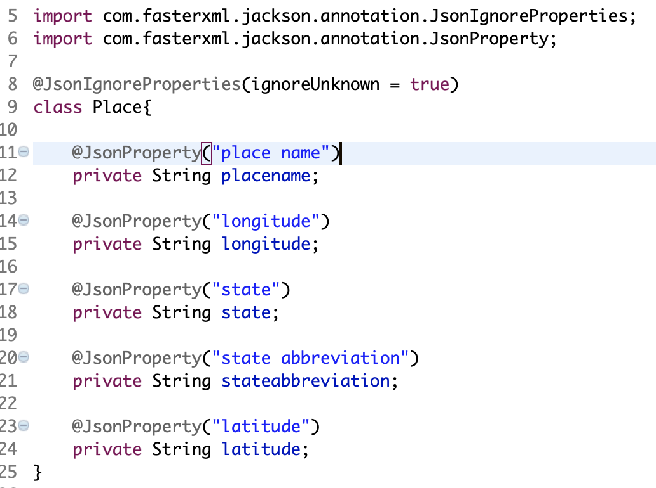
Cont...
@JsonIgnoreProperties:
@JsonProperty(ignoreUnknown = true/false), tells Jackson ObjectMapper to ignore/not to ignore json fields(unknown) while mapping to Java object.

Slide 15
Cont...
@JsonNaming:
It is a strategy that can be used to define how the Json property should appear after serialization
Jackson provides following custom naming strategies.
SnakeCaseStrategy – properties will be in snake_case format. Eg: first_name.
UpperCamelCaseStrategy – properties will be in UpperCamelCase format. Eg: FirstName.
DefaultStrategy – properties will be lowerCamelCase format. Eg: firstName.
DefaultStrategy – properties will be lowerCamelCase format. Eg: firstName.
DefaultStrategy – properties will be lowerCamelCase format. Eg: firstName.

Slide 16
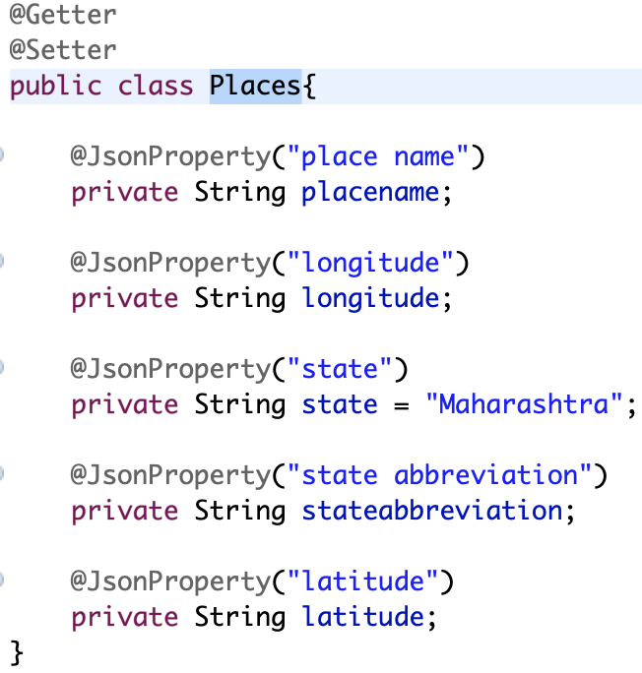
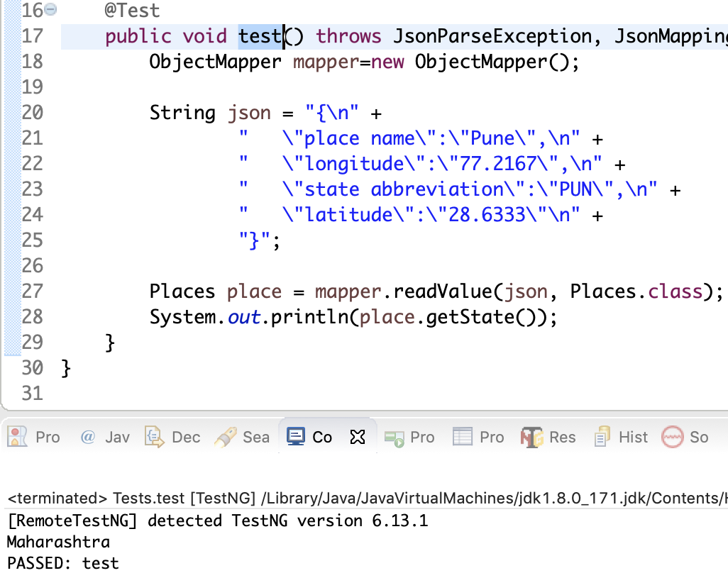
Cont...
@JsonProperty (with default value)
We can set default value if json does not have the field

Slide 17


